Slide 1
Project Meeting
2018/10/31

Slide 2

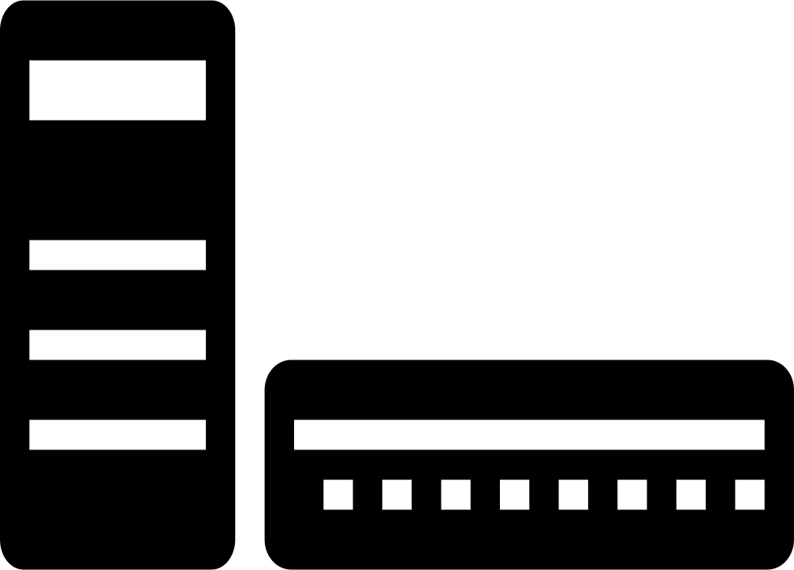


Structure
Cloud
Fog
Sensor

Slide 3
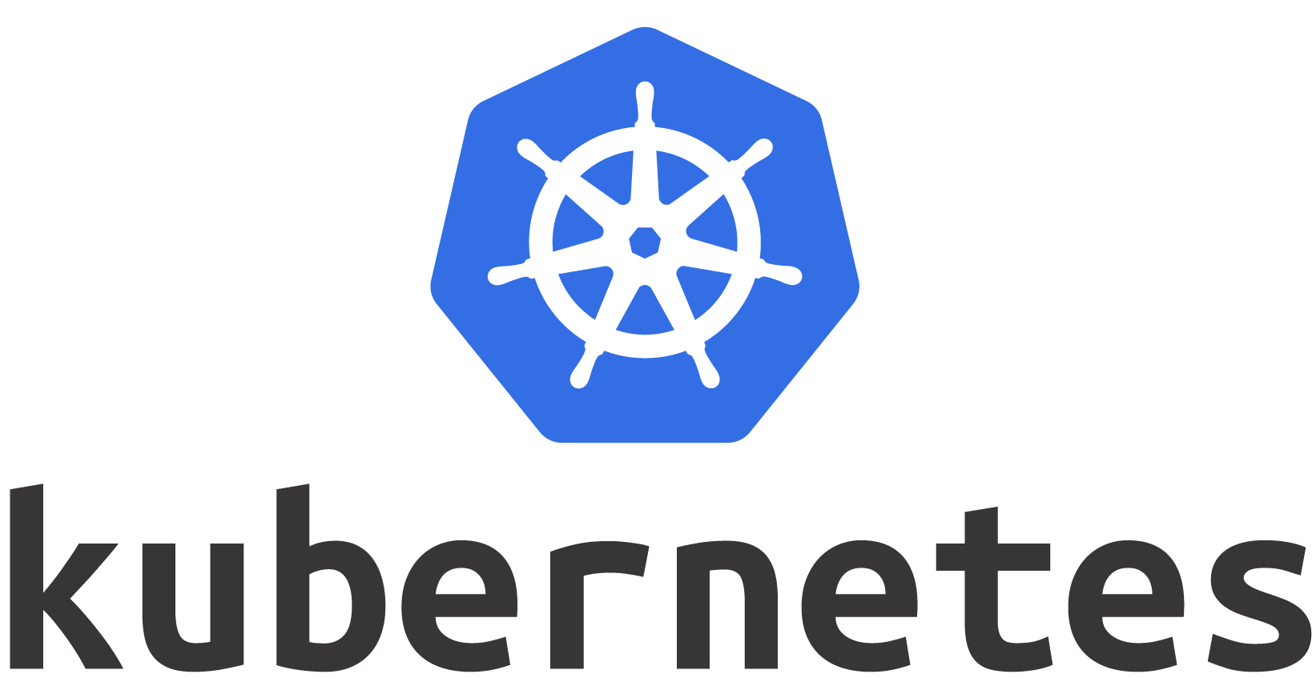


Architecture
Cloud
Deep Learning
Training Environment
Bockchain hash data
Bockchain hash data
anomaly alarm
DNN weight & bias
anomaly alarm
DNN weight & bias
original data
original data
container
container
MQTT Broker
sharing ledger
MQTT Broker
Node
DNN Model
DNN Model
Blockchain
Blockchain
sensor data
sensor data
Smart Meter Simulator
Smart Meter Simulator
Smart Meter Simulator
……
Sensor

Slide 4
Data flow chart
Sensor data
?
LoRa gateway
Hyperledger Fabric
Send data to cloud
DNN model
Send ledger
data
normal
true

Slide 5
Sensor
Raspberry Pi
LoRa
antenna
Smart meter
Simulator

Slide 6
Gateway
Raspberry Pi
LoRa
antenna
container
MQTT
Broker
LoRa
Gateway
Bridge
Message
Management program
Transmis-sion
after
DNN
program
DNN
Model
Data anomaly
behavior
program
BlockChain
Notes:
LoRa channel: 台灣使用920∼925MHz頻段的923MHz
LoRa Gateway Bridge is a service which abstracts the packet-forwarder UDP protocol into JSON over MQTT

Slide 7
Transmission mechanism
Use LoRa gateway Bridge service catch value
Message Management program use pipeline send data to DNN Model
Transmission after DNN program send result and data to BlockChain
Notes:
LoRa Gateway Bridge是一種通過MQTT將包轉發器UDP協議抽象為JSON的服務
無線電波(Radio Frequency, RF)

Slide 8
Cloud
Server
Kubernetes
Hyperledger Fabric
DNN
Environment

